Slide 1

5th Annual Statewide Local Interagency Team Meeting
Brought to you by the State Interagency Team
September 26, 2019
Waterbury, Vermont
9:00-3:00

Slide 2
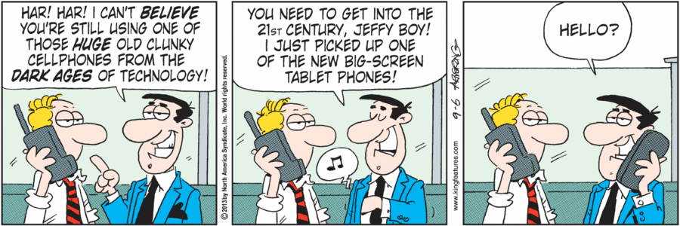
Logistics
Restrooms
Lunch and pre-ordering
Privacy for phone calls
Getting out of the complex (construction updates)

Slide 3

Welcome
Dan French, Secretary, Agency of Education
Camille George, DAIL, Acting Commissioner
Ken Schatz, DCF, Commissioner
Sarah Squirrell, DMH, Commissioner
We don’t have to do it all alone. We were never meant to.
~ Brene Brown

Slide 4

What do you see as the challenges children, youth and families face today in Vermont? What values do you believe should guide our work together?
What do you value most about interagency collaboration? What is your vision and how do you see act 264 playing a role in that vision?
If you have had an experience in your work where you saw some change for a family or child that required out of the box thinking and collaboration, could you describe that?

Slide 5

Updates and Highlights

Slide 6
New logo!!!
Thanks to VFFCMH and the incredible talents of the youth artist who created this!

Slide 7

What do your Act 264 Board Survey Results Tell Us?
Challenges
Workforce issues across all agencies/schools
Acuity of child/family need
Lack of funding, resources, psychiatry, transportation
Waiting lists for programs/services
Having representation from schools
Intergenerational poverty and trauma.
Ongoing challenges related to funding silos
VT residential options
Finding a local parent representative
Connecting Parent Rep to families in advance of meeting; assistance in completing forms, explaining process
How do we do the system work needed to train
Relationship with SIT is less clear
Process can be overwhelming for families: meeting is stressful, terminology confusing, forms are lengthy and overwhelming
Lower numbers of family consultations
Lack of community resources

Slide 8

What do your Act 264 Board Survey Results Tell Us?
Strengths
Collaboration
We are good at looking broadly at the system of care issues
Willingness to think outside the box to solve a problem
The commitment of the members who attend each month
Everybody really cares and tries to remove barriers
Parent voice at the table
Our LIT has multiple members and agencies represented.
Possibility of assuming concerns are resolved at CSP level or other resource team since there are not many referrals to LIT
  Our LIT meets 2 times a month
  Flexible approach with families, meets families where they are at
  We have extended members that will attend as needed from the community
  ACES is a subgroup of LIT
  A great strong team with many years of experience
  Willingness to take on community issues such as truancy
ALSO…
Your results get incorporated into the Annual SIT System of Care Report
We will discuss your responses more when we come this year to visit your LIT

Slide 9
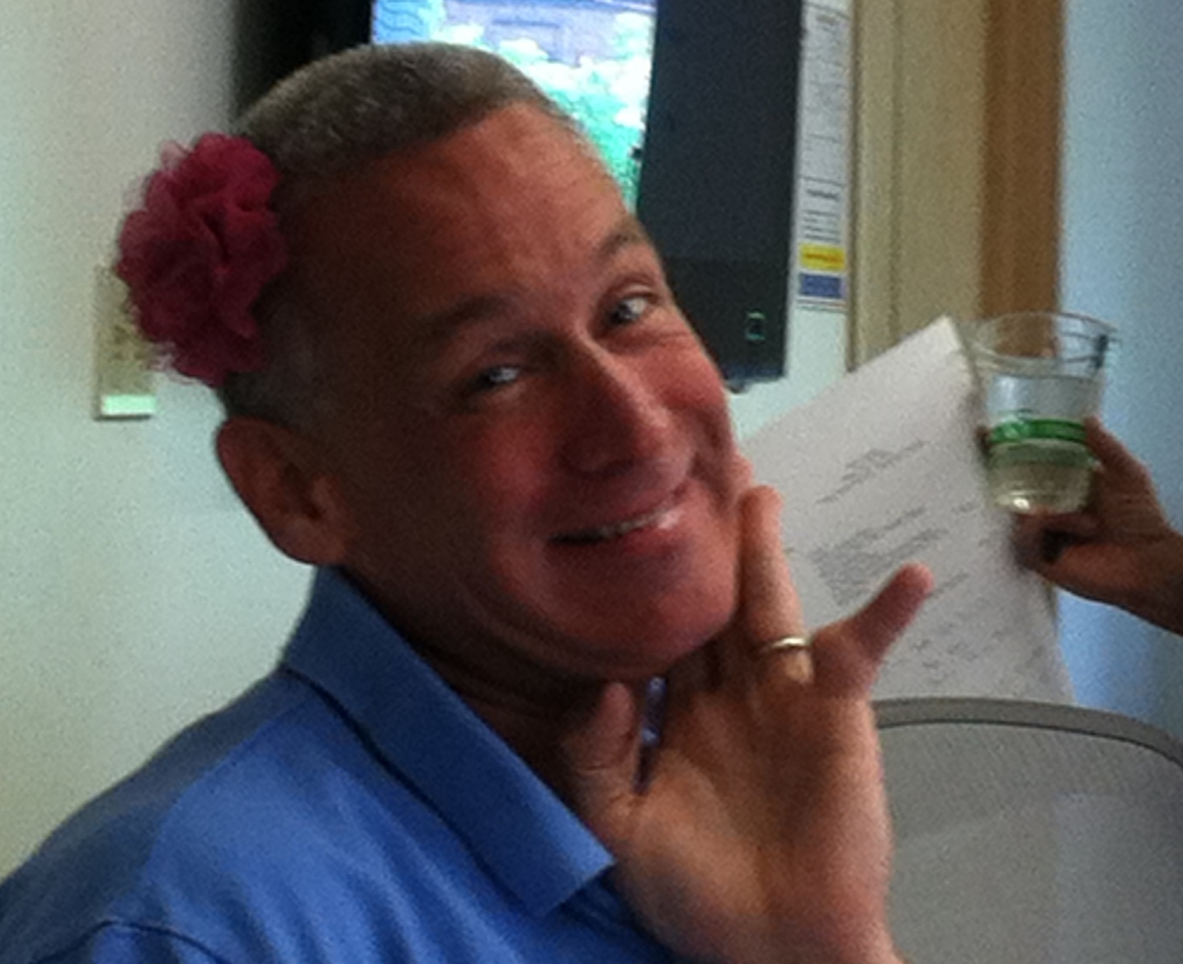
Special thanks to our CSP form update group
Diane Bugbee, DAIL-DDSD
Marc Carr, DCF-FSD
Alicia Hanrahan, AOE
Amy Lincoln Moore, VFFCMH
Tracey Mongeon, DMH
Kiah Palumbo, DMH
Dana Robson, DMH
Erika Rojas, DMH
Cheryle Wilcox, DMH

Slide 10

CSP Form Updates
Results of feedback and what changes happened as a result (we got over 120 responses-thank you!)
  What gets filled out and when?
  The value of follow up meetings: you have more space to write information in about these on the new form
  CRC packet needs to be filled out as a team
  How do I, as the caregiver, prefer to receive support? (i.e. do I prefer to see written materials, hear about it, talk about it, meet someone who is having similar challenges, do I need an interpreter because I’m an English learner, do I need accommodations for a visual or hearing impairment?)
  Shifted the language in Behavioral Concerns (removed Issues) more family-friendly and less clinical
  Supports and Services-combined some items so the list wouldn’t be so long and added more empty boxes for team brainstorming
  Facilitator’s guide-a support document to go with the CSP form!

Slide 11

Practice Guidance
  Having families present at LITs
  LIT Practice Guidance

Slide 12


System of Care Report
Where do I find it? https://ifs.vermont.gov/docs/sit
What is it?
What’s in it?
Bonus question: Where can you find the pictures on this slide?

Slide 13

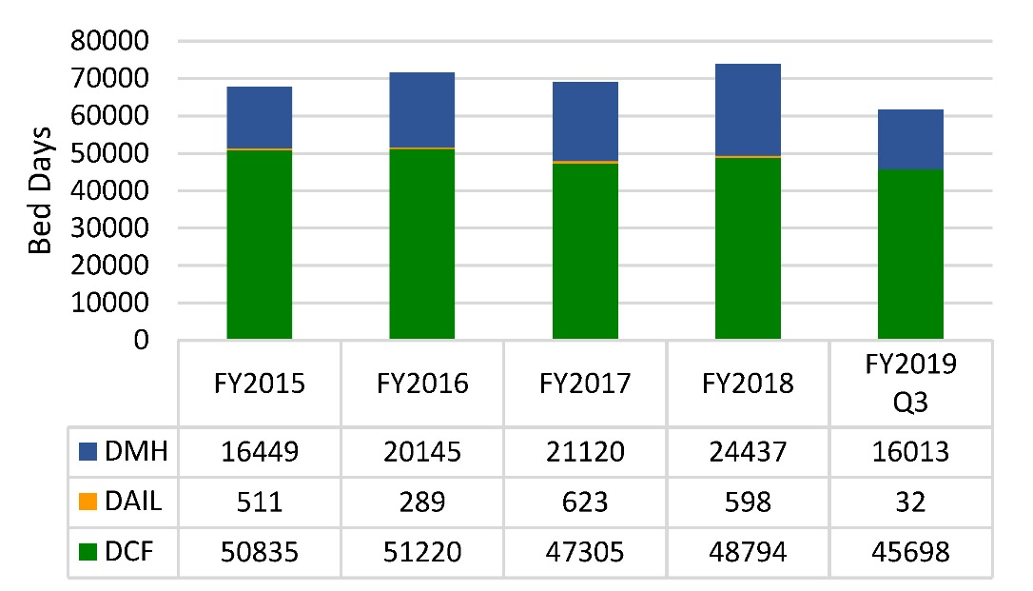
Quarterly Residential Data
Total Residential Bed Days by Department
per Fiscal Year Through FY19Q3
“Every kid needs a family. This, we know. We know it when we look at our own children and think about our dreams for them. We know it in our hearts, in our bones and from our own stories. Whether “family” means a mother and father, a single parent, a beloved aunt or uncle, a grandparent or a caring foster or adoptive family, this bond gives meaning to our successes, cushions our hardships and allows us to be most ourselves. A family loves us at our worst and summons our best when nothing else will. A family provides a compass from birth to death. It is the definition of home.
We know that children do best in families. While some children grow up to succeed without a family, we would never willingly choose such a path for our own kids. Yet too many children are not living in families during the most critical years of their physical, emotional, psychological and social development and the most vulnerable moments of their lives.”
Policy Report: Every Kid Needs a Family by Annie E. Casey, May 2015

Slide 14

What’s happening with Mobile Response?
Better outcomes in both cost and quality of care are achievable through community-based initiatives that redefine the meaning of “crisis” and address and stabilize behaviors prior to escalation to the level of requiring inpatient care.
~SAMHSA

Slide 15
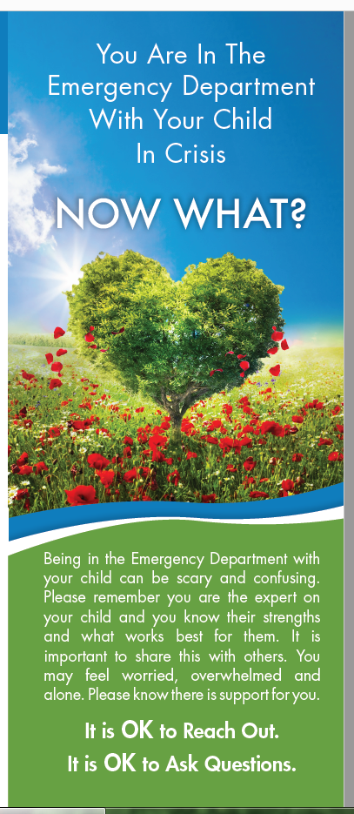
A new resource for caregivers

Slide 16

BREAK TIME

Slide 17

LIT in Action: A Family-Centered Local Interagency Team Meeting
Thanks to our brave STARS!
Cindy Tabor: Susan, Parent of Tyler
Amy Lincoln Moore: Amy, LIT Parent representative
Erika Rojas: Erika, LIT Coordinator
Amy Roth: Deborah, Designated Agency, DS LIT representative
Suzanne Legare Belcher: Suzanne, AHS Field Director
Marc Carr: Marc, FSD Director
Dana Robson: Dana, School Social Worker
Karen Price: Karen, Susan’s best friend
Karen Bielawski-Branch: Karen, Children’s Integrated Services, Specialized Child Care Coordinator
Diane Bugbee: Vivienne, LEA
Jessica Bernard: Videographer
Cheryle Wilcox: Director
Laurel Omland: Special Consultant

Slide 18

Discussion Questions
Clip 1: Parent Representative preparing a Parent for upcoming Local Interagency Team Meeting
  What value does the parent representative bring to this process?
  What other preparation/conversation do you think should happen with the family prior to LIT?
  What would you want to make sure every parent knows before they come to LIT?

Slide 19
Discussion Questions
Clip 2: Introducing and Setting the Tone for LIT
  What worked well about this introduction?
  Share how you decide who will be at LIT when a family member is coming.
  How do you ensure families feel supported and understand the roles of who is at the LIT meeting? What else might you do to help a family feel more comfortable being with so many professionals at once?

Slide 20

Discussion Questions
Clip 3: Sharing Resources and Offering Support
  What do you think are best practices when a family is asking for a residential program? What do you think are the best practices for considering whether a residential placement is needed? How do you respect and honor a family’s view when they believe residential care is needed and you don’t think a child needs this level of care?
  Who follows up on the “to dos” from your LIT”? How do you ensure all steps from the follow up plan happen and are coordinated?

Slide 21
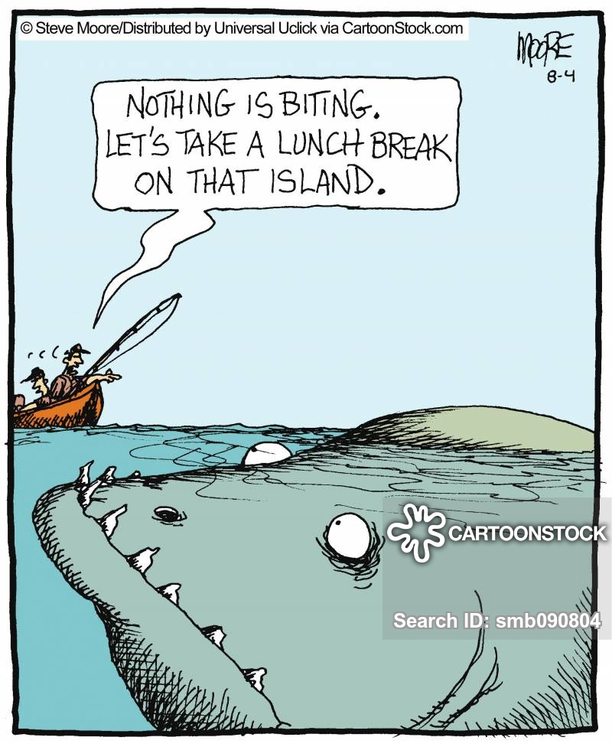
Have a Safe and Enjoyable Lunch Break!

Slide 22

Charlie Biss Child, Youth & Family Voice Champion Award
In December of 2017, The Vermont Federation of Families for Children’s Mental Health nominated Charlie Biss for a Life-Time Achievement Award upon his retirement after serving 30 years with the State of Vermont, as the Child, Adolescent and Family Unit Director for the Department of Mental Health.
In honor of Charlie Biss and his life-time achievements in Children’s Mental Health, the Vermont Federation of Families’ Board of Directors instituted an annual award in his honor.
Notes:
Cindy

Slide 23
Debut: family friendly training video on act 264 https://vimeo.com/362075091/2cf342689b
Thanks to the Vermont federation of families for children’s mental health for their amazing work to make this happen!

Slide 24

Local Strategic Planning Time

Slide 25

News You Can Use: What You Want People Across the State to Know about Your Region
1. What is your biggest takeaway from today that you want to incorporate into your LIT?
2. What did you accomplish from your strategic plan that you created last year?
3. What is one goal your team has over the next year?

Slide 26

Thank you for coming.
Please fill out your evaluations to assist us in future planning.
For questions about this presentation or Act 264 please contact SIT Co-Chairs:
Cheryle Wilcox at Cheryle.Wilcox@Vermont.gov, 802-760-9171 and Diane Bugbee at Diane.Bugbee@Vermont.gov, 802-241-0154

