Slide 1
CANS School Module
Amy Irish, MA, BCBA
Northwestern Counseling & Support Services

Slide 2
CANS School Module: Who & What
Achenbach
Core CANS
Fall 2018 NCSS Pilot:
Core CANS
+
Embedded School Module
Spring 2019 NCSS Pilot:
Core CANS
+
School Module
Fall 2019
School Module

Slide 3
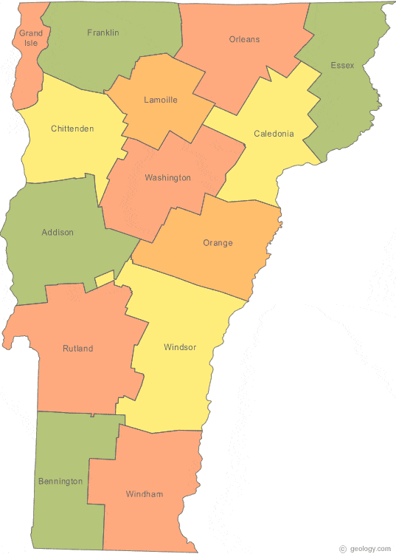
Why the Core CANS
Why Do we need Data?
Success Beyond Six
Reporting to the Vermont Department of Mental Health & VT Legislature
Why The Move to Core CANS?
More meaningful data for families, clients & schools
Quick & Easy Sharing at team meetings
Ability to look for impact across domains
Notes:
Previously ASEBA ---hard to understand, Minimal “Analysis”
Allow school teams to have a shared understanding of S&N
Ease of Sharing results

Slide 4
Why NOT the Core CANS
Difficulty Sharing
Parental Substance Use
Family resistance to share information
Wasn’t Reflecting True Impact
Minimal questions that addressed school
Questions didn’t hit at the level of needs students in BI Programs were presenting with
Notes:
Difficulty– Created challenging conversations with families
Data: Confusion with non school staff, More than 2 CANS per year, Intake- NEW CANS, Discharge- No NEW CANS
November & April vs. 6 Months

Slide 5
Pilot: Fall 2018
Developed a Subcommittee & PDSA
Identified Adjustments
Built CANS School Module into Core CANS
Small pilot group
Notes:
Waterfall from Core
2 kids from each SBP

Slide 6
Why the CANS School Module Embedded In Core CANS
Why Embedded
Already triggering Core
Minimize number of assessments
Increased Collaboration

Slide 7
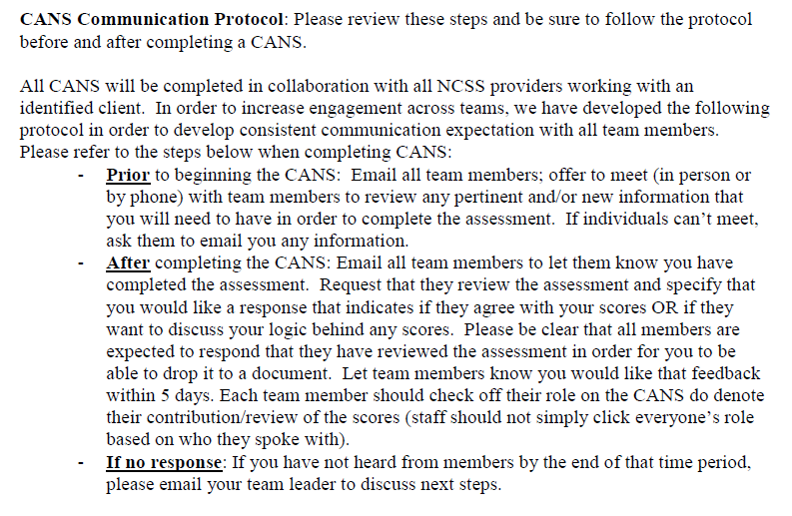
Communication Protocol

Slide 8
What is the School Module?
Notes:
Questions to Consider

Slide 9
What Did We Adjust?
Bullying & Harassment
Gang Involvement
Notes:
VT State laws to protect students from bullying and harassment

Slide 10
What We Have Learned…
Data Point Struggles
Intake & Discharge from School Programs
Triggering Challenges
Confusion
Notes:
Data: Confusion with non school staff, More than 2 CANS per year, Intake- NEW CANS, Discharge- No NEW CANS
November & April vs. 6 Months
Non SBP thinking it was triggered by accident & having deleted

Slide 11
Pilot Spring 2019: How We Adjusted
Separated School CANS Module from Core CANS
Developed hierarchy for who is triggered the School CANS
Developed Trigger Schedule
SBP Intake
October & April
Discharge from SBP

Slide 12
Where We Are Going…
Strengths Sections
Communimetric
Treatment Planning
Statewide Fall 2019

Slide 13
Thoughts, Questions & Conversation…

