Slide 1
CANS Data: Putting It To Work For You
Alison Krompf, MA
Valerie Wood, PhD

Slide 2
Utility of the CANS
Based on the implementation of the CANS in three pilot regions, we learned that the CANS is useful for:
Informing treatment planning
Monitoring change (improvement) over time
Helping with inter-agency communication

Slide 3
Experience of MH Clinicians: Progress Monitoring
“what I’ve found the most useful with the CANS in the opportunity that I’ve had to work with it and doing it so many times, I love the pie charts. And the fact that they pull on to the document together and see the comparison and the progress that is happening. Certainly, I’ve seen risk for the kiddos, the caretakers is more static. In that, we’ve always kind of know that it’s a little more challenging in helping the adult parents. They change, but certainly change is being reflected for the kids.”

Slide 4
Individual Overall Progress

Slide 5
Experience from MH clinicians: Progress Monitoring
“Well, I get really excited when I see the pie graph changing and there’s less red and more yellow or green. And then I’m able to print that out and bring it to the family. I find it to be really concrete. It provides a visual for the family, where sometimes they get stuck in the mire and sometimes they’re not feeling that the change has happened.”

Slide 6
Inter-Agency Communication
Mental health and child welfare professionals in the 3 pilot regions had higher ratings on:
Inter-agency collaboration
Trust
Collaborative case planning

Slide 7
Experience of MH Clinicians: Inter-agency Communication
“we keep trying to pull all of our staffs together so we’re just constantly building relationships and creating opportunities for people to be together and we need a topic . . . so that’s the topic we use is treatment planning with the CANS and the ARC.”

Slide 8
Experience of MH Clinicians: Inter-agency Communication
“So I love CANS . . . and it has that team approach, so that everybody’s doing that together and it’s not just you know, the clinician saying, ‘this is what the kids needs’ and the school saying ‘no, I think . . .,” you know it’s really looking at these areas and what we need to focus on, particularly when families have so many areas of need.”

Slide 9
Putting the CANS in Context
“ . . .the other piece or variable is that our staff is a pretty experienced, they’re all masters level staff who have got long years of experience . . . they know what they’re doing and they’re doing it. And they’ll use the tool but they see it as a tool and will put it in that bucket. And they see themselves as responsible for creating the treatment plan that integrates what they’ve gained from their experiences and their work and then the tools come into that but they’re not, they will not be tool reliant.”

Slide 10
Cans Context II
“. . . I’ve had push back on every tool that we’ve ever tried to use. It’s not about the CANS, it’s about I have to do this thing. You know that’s still a factor. . .”

Slide 11
Role of Agencies
“I think it’s really a matter of the agencies prioritizing that and we should review the CANS, but I think there’s always that struggle for teaming. I see it as a function as how the agencies team as well as the fact that here’s an outgoing survey that we’re going to do and have half an hour to talk about all the other things we’re going to need to do. SO its not an ideal situation to complete it unless the agencies can really make time to do that. But there are times where usually staff and individual workers will collaborate around the CANS and that can be really effective.”

Slide 12
What story is our Vermont CANS Data telling?

Slide 13
Highest Scoring Needs for Children/Youth in DCF Custody
Notes:
6 out of 9 regions had an absence of Community Connections as their highest aggregate scoring item on the CANS
Absence of Resiliency, Optimism, and Child Involvement with Care are consistently within the top 10 for all regions
Adjustment to Trauma, Family Discord and Anxiety are consistently in the top 10 for all regions

Slide 14
Children/Youth in DCF Custody -Building Strengths over Time

Slide 15
Children/Youth in DCF Custody -Building Strengths over Time

Slide 16
Program Differences

Slide 17
School Based Clinician Program - Item Level Analysis over Time

Slide 18
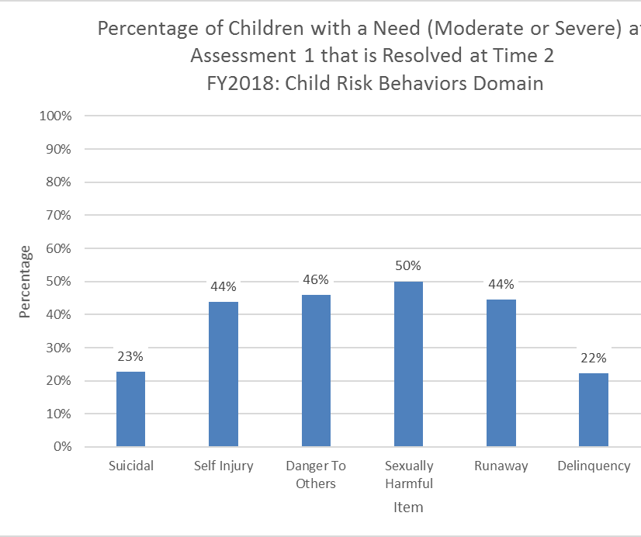
Behavioral Intervention Impact On Risk Behaviors
This chart shows the percentage of students in the BI Program with a Risk Behavior Need present in the fall that was resolved by the by the spring assessment.
*Resolved is defined as reducing below a score of 2

Slide 19
Overall Impact – Children/Youth In DCF Custody
* Support Intensity Score = Severity Score
Notes:
Support Intensity Score = Sum of 2's and 3's out of 50 item CANS

Slide 20
Utility for DA Supervisors

Slide 21
Let’s Get Interactive!
A tour of CANS profiles for 779 children/youth!

Slide 22
Resources:
http://www.communitydataroundtable.org/
https://praedfoundation.org/tools/transformational-collaborative-outcomes-management-tcom/

